Slide 1

TEXT SUMMARIZATION
Team Members
Neil Malu
Rishabh Agarwal
Aditya Tornekar
Vindhya Ravi Prakash
Pawan SP

Slide 2
Table of contents
1
2
3
4
5
6
Introduction
NLP Technique Used
Intro to topic and our research question
Major NLP Techniques used to solve our problem
Extractive Text Summarization
Abstractive Text Summarization
Brief review of related works, our approach, results and challenges faced
Brief review of related works, our approach, results and challenges faced
Challenges Faced: Overall
Evaluation Conclusion & Future work
Challenges faced, explanation to the outcomes

Slide 3
1
INTRODUCTION

Slide 4

Text Summarization
“Task of producing a concise and fluent summary while preserving key information content and overall meaning”
There are two types:
Extractive Text Summarization
Identify the important sentences or phrases from the original text and extract only those from the text
Abstractive Text Summarization
Generate new sentences from the original text using NLP and Deep Learning.

Slide 5

Motivation
Due to COVID all the lectures/conferences are mostly done online and zoom generates an audio-transcript file, which could be used to get a summary of the entire lecture or the conference.
Enormous amount of data generated so improving storage and efficiency is crucial.
Goal is to implement and analyze different extractive as well as abstractive methods and see which one works best for certain kinds of data.

Slide 6
NLP Techniques Used
Regex
Tokenization
Stopwords
Removal
TF-IDF
Contractions
Transformer Models
NLTK
Similarity
Techniques

Slide 7
3
FRAMEWORK

Slide 8
Our Approach - Framework
Web - React frontend + Django backend
Inputs - User provides either texts or files with text in them.
Sample datasets - Zoom audio transcripts (conference recordings)
Data cleaning:
Extract data based on the type of the file
Identify the main speaker (specifically in the case of a lecture or presentation)
Remove noise - sentences that have fewer than 5 words

Slide 9
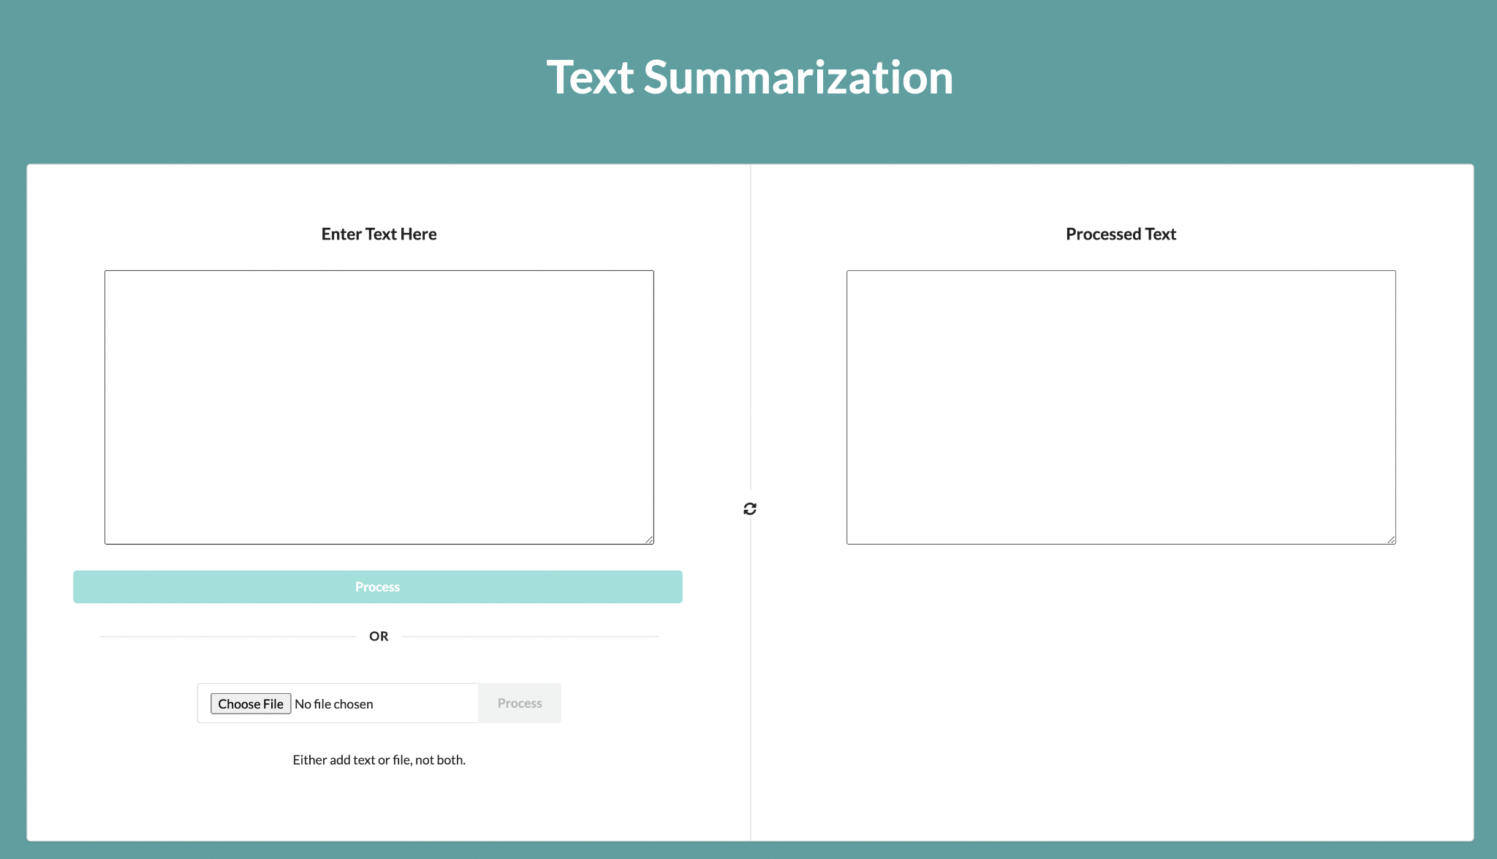
Framework - Screenshot
Future work
Add options for type of summary
Max number of sentences in summary
Evaluation of the summary with a variety of scores

Slide 10
4
EXTRACTIVE TEXT SUMMARIZATION

Slide 11

4
EXTRACTIVE TEXT SUMMARIZATION

Slide 12
Extractive Text Summarization
Related Works
Sentence similarity:
Generates Similarity Matrix of all the sentences, rank them and pick the top k sentences. (k: user input).
Word Frequency:
NLTK Word Frequency: Word frequencies and weighted frequencies are calculated from them and assigned to the sentence. N sentences with the highest scores are selected as the summary.
Latent Semantic Analysis, Luhn, KL-Sum and Lex Rank Summarizers

Slide 13
Extractive - Similarity Matrix
Unsupervised Learning
Extract the sentences, convert to lower case, remove stopwords
Convert sentences to “vectors”
Assign weights to parts of the sentences that are deemed important.
Build a similarity matrix using cosine similarity
Rank the sentences based on the matrix
Pick the top K sentences for summary

Slide 14
Extractive - NLTK Word Frequency
Using regex, remove the stopwords, punctuation, numbers & special characters from the main text & store in a variable.
Then word tokenize the preprocessed text and calculate the word frequencies for the words. Compute the weighted frequency for the words by dividing the frequency by the frequency of the most occurring word.
Tokenize the unprocessed text at the sentence level and assign the weighted frequencies for the words in the sentences.
Choose the top N sentences with the highest score for the summary.

Slide 15
Extractive - Latent Semantic Analysis, Luhn, KL-Sum & Lex Rank
Latent Semantic Analysis: It is a form of unsupervised learning which extracts semantically significant sentences by applying singular value decomposition(SVD) to the matrix of term-document frequency.
Luhn Summarizer: Luhn Summarization algorithm approach is based on TF-IDF (Term Frequency-Inverse Document Frequency).
KL-Sum Summarizer: It selects sentences based on similarity of word distribution as the original text. It aims to lower the KL-divergence criteria.
Lex Rank Summarizer: LexRank is an unsupervised approach to text summarization based on graph-based centrality scoring of sentences. The main idea is that sentences “recommend” other similar sentences to the reader.

Slide 16
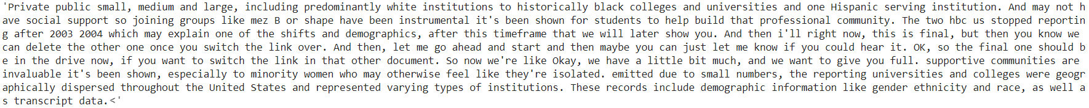
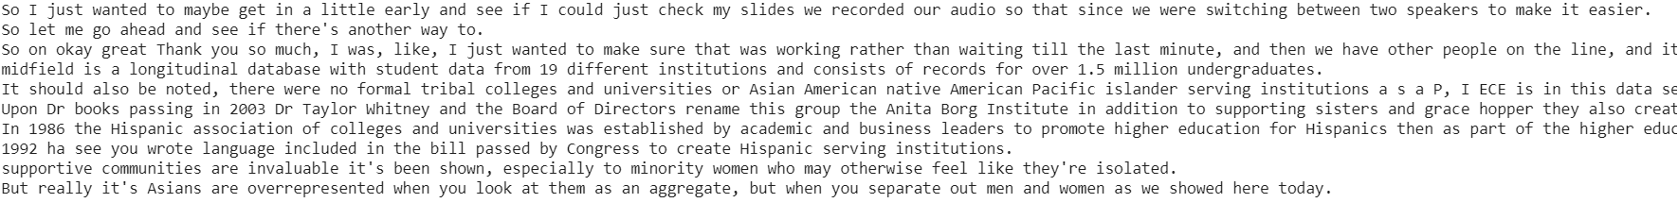
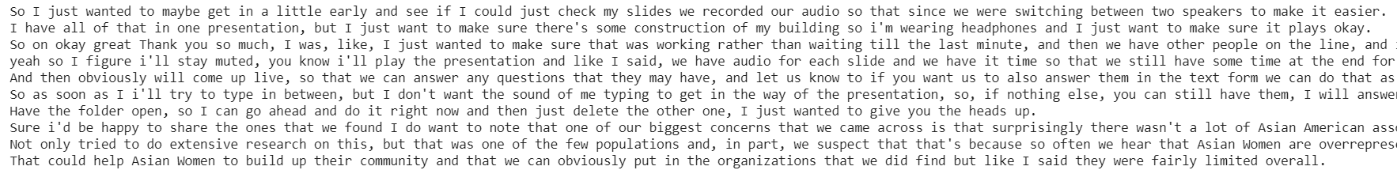
Results
NLTK Word Frequency Summary
LSA Summary
Luhn Summarizer

Slide 17
Challenges - Extractive
Summary cohesion: as usually sentences are extracted and just concatenated to each other, there was no smooth transition between ideas/concepts/topics in different sentences. This required to increase the number of top ranked sentences to choose from to get a proper gist of the text.
This is a performance hit, since training will take more time.
The order of the sentences is changed, so it’s difficult to get a contextual understanding of the information.

Slide 18
5
ABSTRACTIVE TEXT SUMMARIZATION

Slide 19
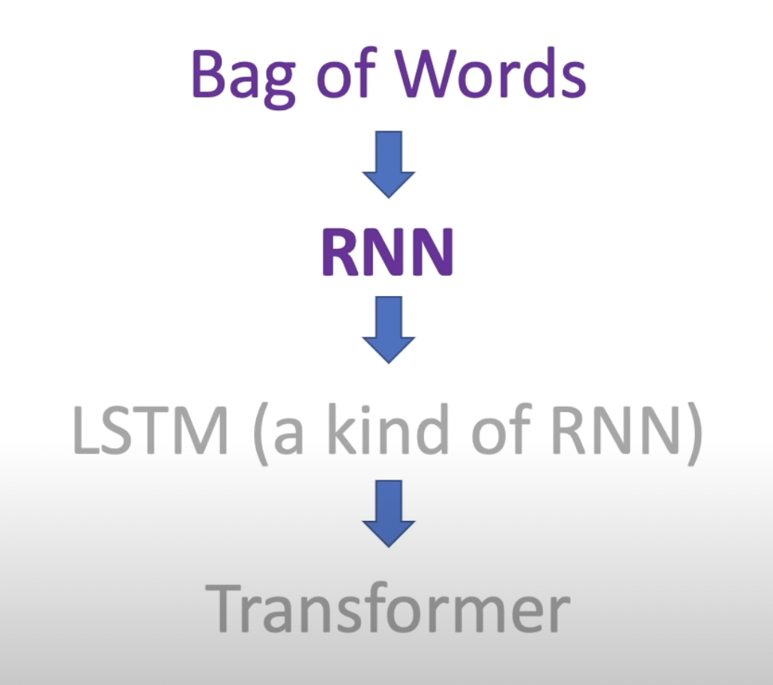
Abstractive Text Summarization
Bag of words: Order not taken into consideration. Bigram/Trigrams too expensive
RNN: Vanishing & exploding gradient
LSTM: Difficult to train & transfer learning never worked
Transformers: Unsupervised text

Slide 20
Abstractive Text Summarization
Related Works
Article 1
Using Seq2Seq Model: LSTM and Attention Mechanism to get the summarization.
Encoder - good for summarizing (good for context representation, for semantic similarity, question answering, sentence classification)
Decoder - good for generating (probability of next word/sentence based on previous sequence)
Hugging Face transformer package - Both
T5 Transformer model - Both
BERT - Encoder only
GPT-2 Transformer model - Decoder only

Slide 21
Our Approach - Abstractive Text Summarization
LSTM and Attention Mechanism
Create a sequence of words
Encode - Use RNN to train the model to predict the next word based on previous words.
Attention Layer will ensure maximum score goes to the most important words in the text based on word count and tf-idf
Decode - Use RNN to predict the next word based on the probabilities calculated.
Requires summary to train it (supervised)
HuggingFace pipeline package
Pre trained model which provides abstractive summary pretty quickly.

Slide 22
Challenges - Abstractive
Seq2Seq - Generating network model takes time. Need to train the model well enough that different texts can be summarized without retraining the model to that text.
HuggingFace API - Max length for tokens is limited at 1024
Naive approach is to break the text into chunks with 1024 tokens, summarize each one and then concatenate them
Better - first carry out extractive summarization and score and rank sentences. Then only use the pipeline API on the most important sentences and use the naive approach if required.

Slide 23
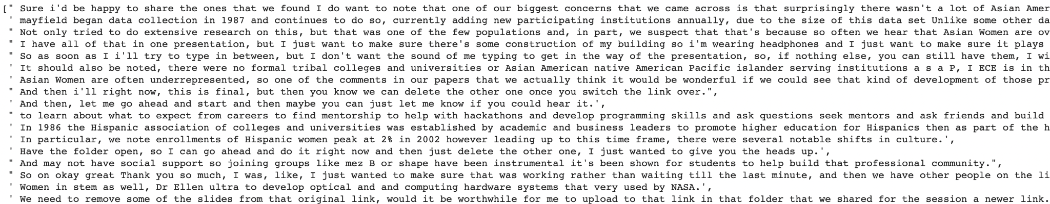
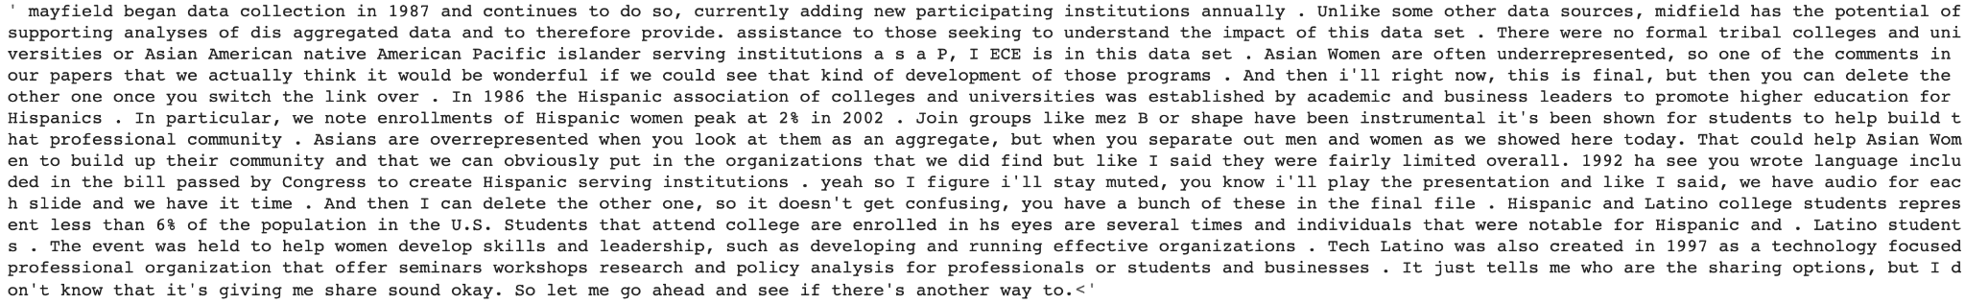
Results
Most important sentences in original text
Huggingface Pipeline API

Slide 24
6
SUMMARY EVALUATION

Slide 25
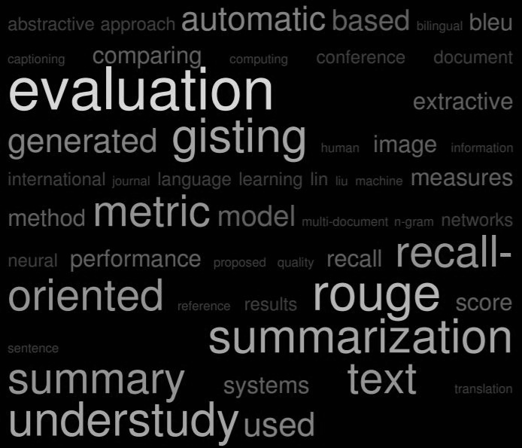
Evaluation Of Generated Summary
Generated text summary using extractive and abstractive methods, but quantification of summary quality was required
Based on Human-Generated Model Summaries:
1) ROGUE: Unigram, Bigram overlap & LCS(Longest Common Subsequence) - F,P,R scores
2) BLEU
3) METEOR, NIST
Alternate Techniques for similarity comparison:
1) Jaccard Similarity: Unique words intersection
2) Cosine Similarity: TF-IDF vectors cosine angles
3) Gensim package

Slide 26
Comparison of Generated Summary
Summarization Method | Jaccard Similarity | Cosine Similarity | Gensim | Average Score | Comments
Sentence Similarity | 0.179 | 0.849 | 0.178 | 0.5135 | ROGUE-score for better evaluation
Word Frequency | 0.214 | 0.819 | 0.176 | 0.403
Latent Semantic Analysis | 0.246 | 0.847 | 0.179 | 0.424
Luhn Summarizer | 0.234 | 0.888 | 0.175 | 0.432
KL Summarizer | 0.103 | 0.709 | 0.171 | 0.327 | Low performance overall
Lex Rank | 0.216 | 0.906 | 0.175 | 0.432
Hugging Face Pipeline | 0.331 | 0.914 | 0.179 | 0.474 | Abstractive still was second best

Slide 27
7
CHALLENGES FACED

Slide 28

Challenges - General + Cleaning + Evaluation
File reading - different types of files so cannot create a separate reader for each type
Using textract package - universal text file reader (doc, pdf, txt, jpeg, html)
Multiple speakers - so far works for a presentation or lecture - but if it’s a podcast, there’s a catch
Currently, we assume majority of the information is spoken by the main speaker
Speed - Both extractive and abstractive are pretty slow
Need to reduce the size of the text as much as possible to reduce computation time.
Text summary evaluation requires human summary models for cross reference and best results

Slide 29
8
CONCLUSION & FUTURE WORK

Slide 30

Future Work & Conclusion
Overall, Hugging Face Pipeline API in abstractive approach and Sentence Similarity in extractive approach gave good results
ROGUE-Score Evaluation using Human Summary Model
BART Abstractive Approach
Skip Thoughts Extractive Approach
Seq2seq improvement and implementation for large datasets
Summarization Use Cases:
Generate summary for Ted -Talks
Generate summary from Meeting Minutes

Slide 31
Thank you :)
Question??

